Slide 1

Cloud Agnostics Mlops Pipeline
Lijo Zechariah James

Slide 2
Contents
Objectives
Cloud agnostics
MLOPS
Kubeflow Architecture
Anatomy of a pipeline
Tools Used
Implementation
Future scope
Conclusion

Slide 3
Objective
Machine learning is complex but really important technology.
We can't live without Machine learning models and significance of this will increase in the future also.
Mlops pipelines increases the quality, simplifies the management process, and automates the deployment of Machine Learning and Deep Learning models in large-scale production environments.
The main objective is to build a Cloud Agnostic Mlops Pipeline for machine learning model.

Slide 4
Cloud Agnostic
Cloud agnostic refers to tools, platforms, or applications that are compatible with any cloud infrastructure and can be moved to and from different cloud environments without any operational issues.
Pro's
Cost
Time to market
Flexibility
Scalability
Efficiency
Reliability

Slide 5
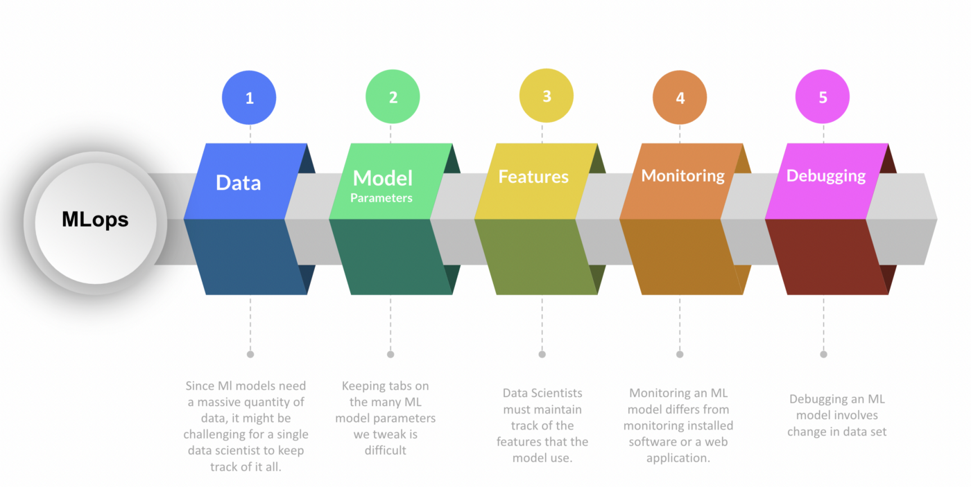

Slide 6
Kubeflow
The Kubeflow project is dedicated to making deployments of machine learning (ML) workflows on Kubernetes simple, portable and scalable.
Contains inbuild Jupyter notebooks which helps to build pipelines really quickly.
Contains curated set of compatible tools and other extensions for smooth running of Mlops pipeline

Slide 7
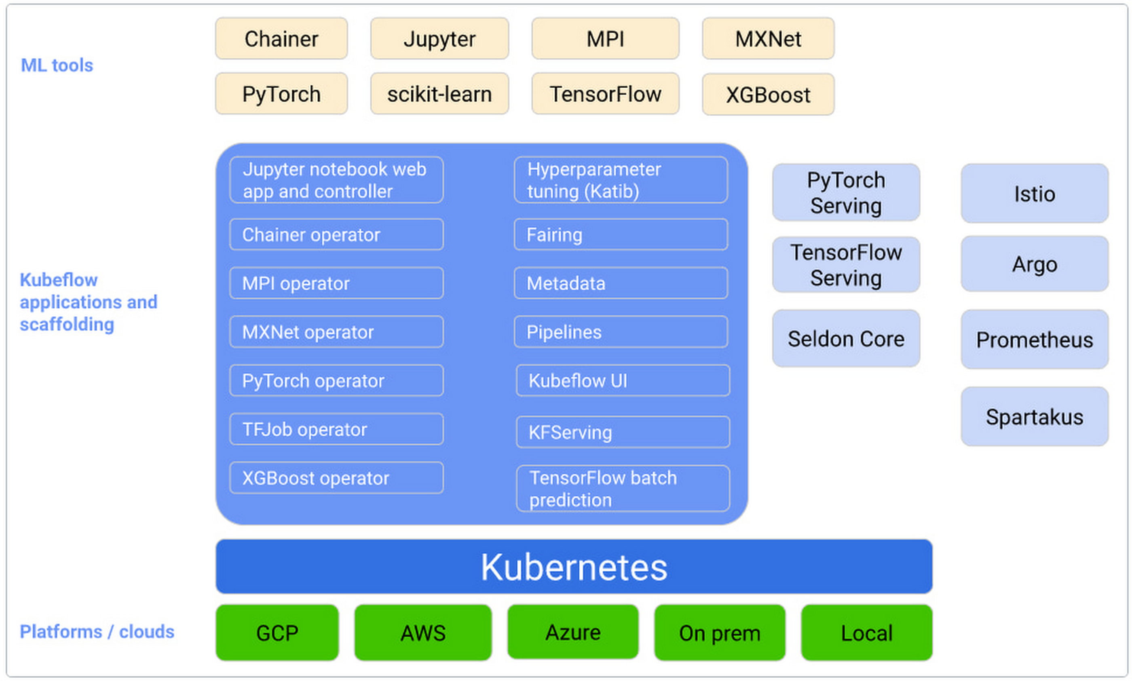
Kubeflow Architecture

Slide 8
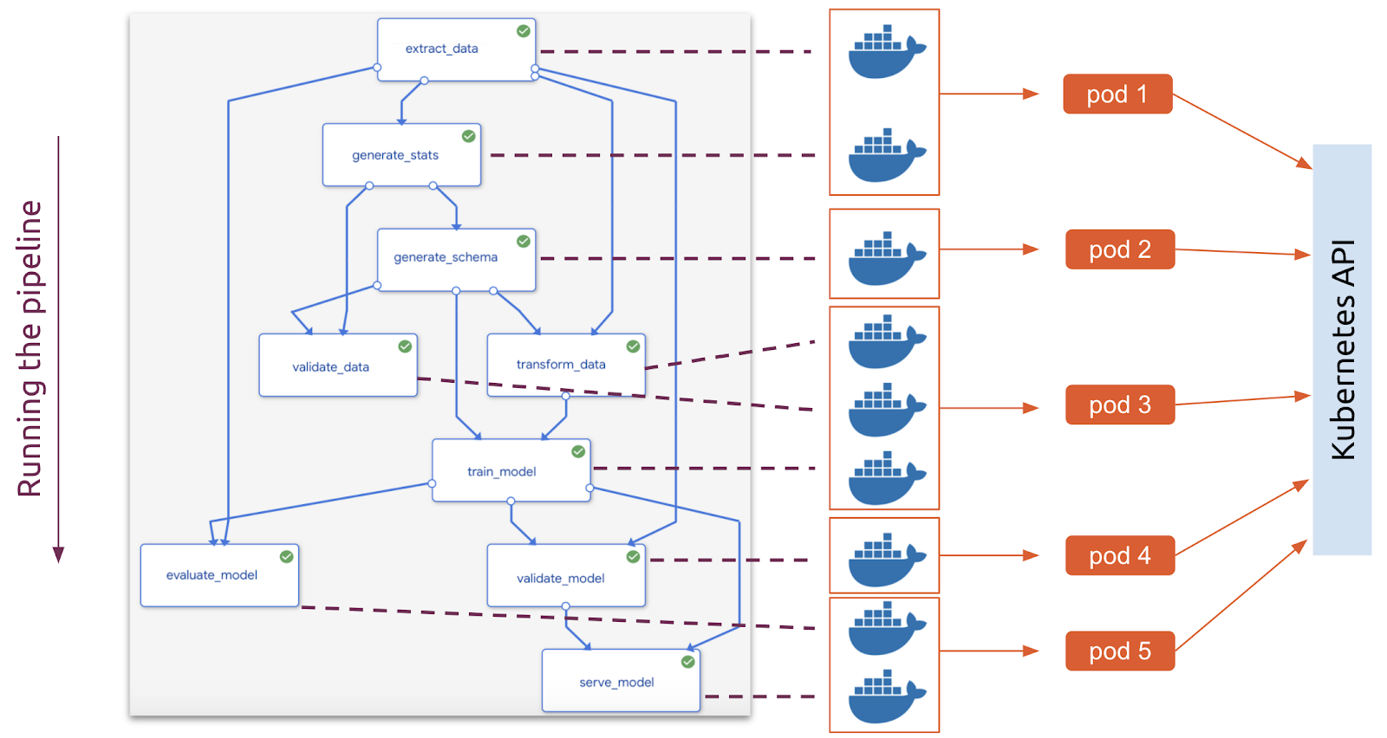
Kubeflow Pipeline

Slide 9
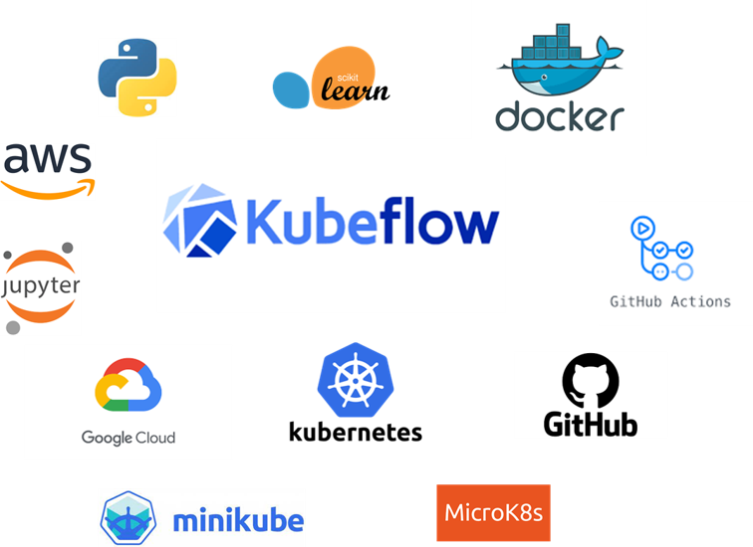

Tools Used

Slide 10
DEMO
Code Walk Through

Slide 11



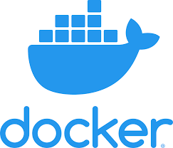
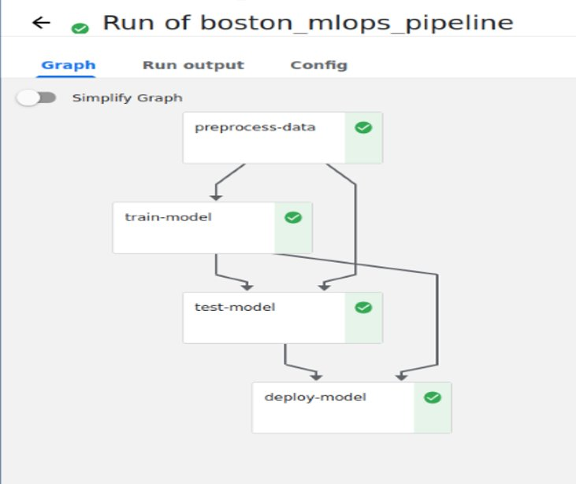
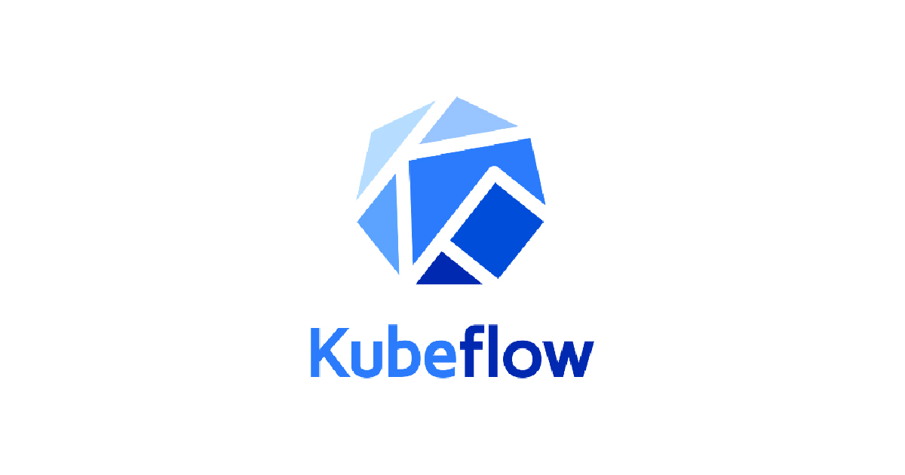

WORKING

Slide 12
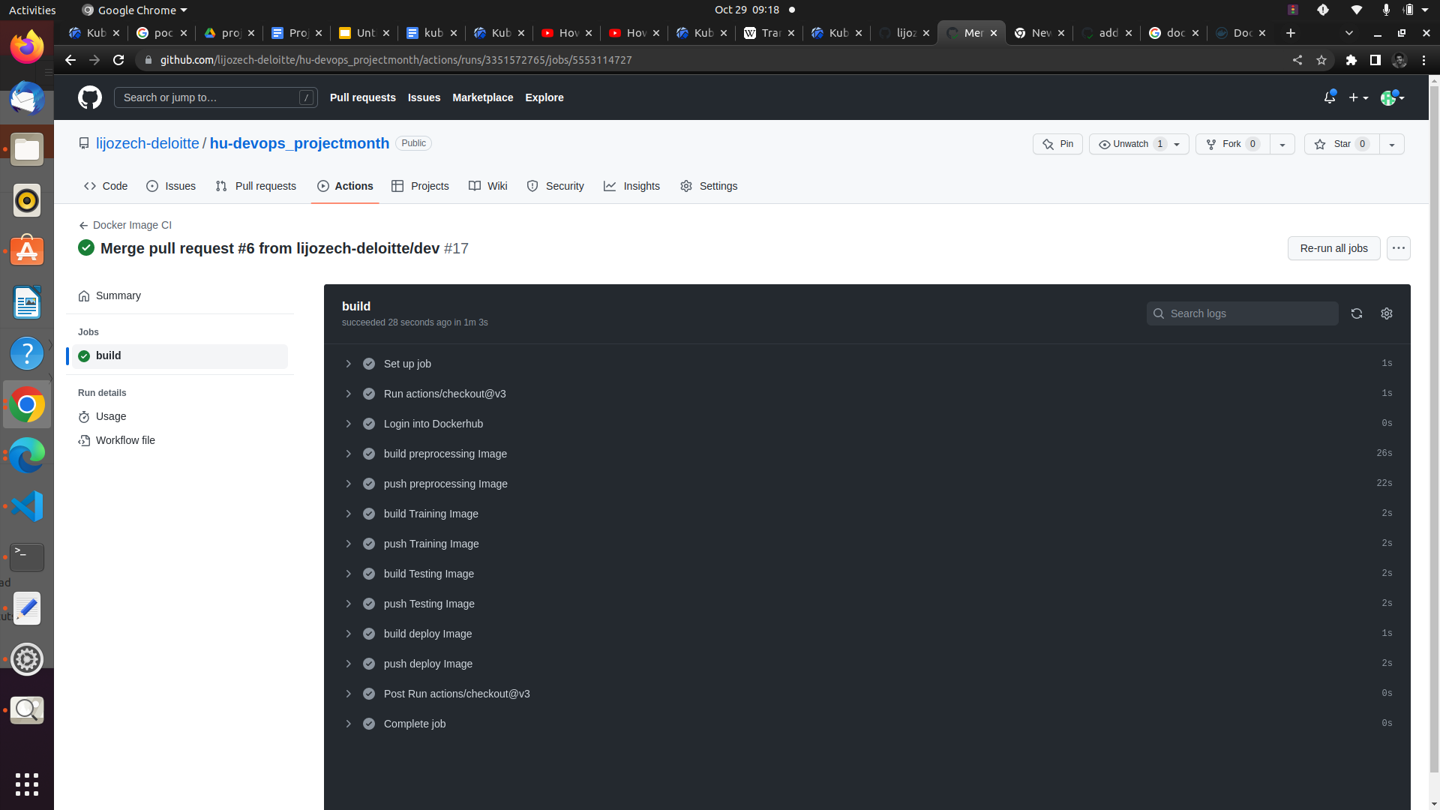
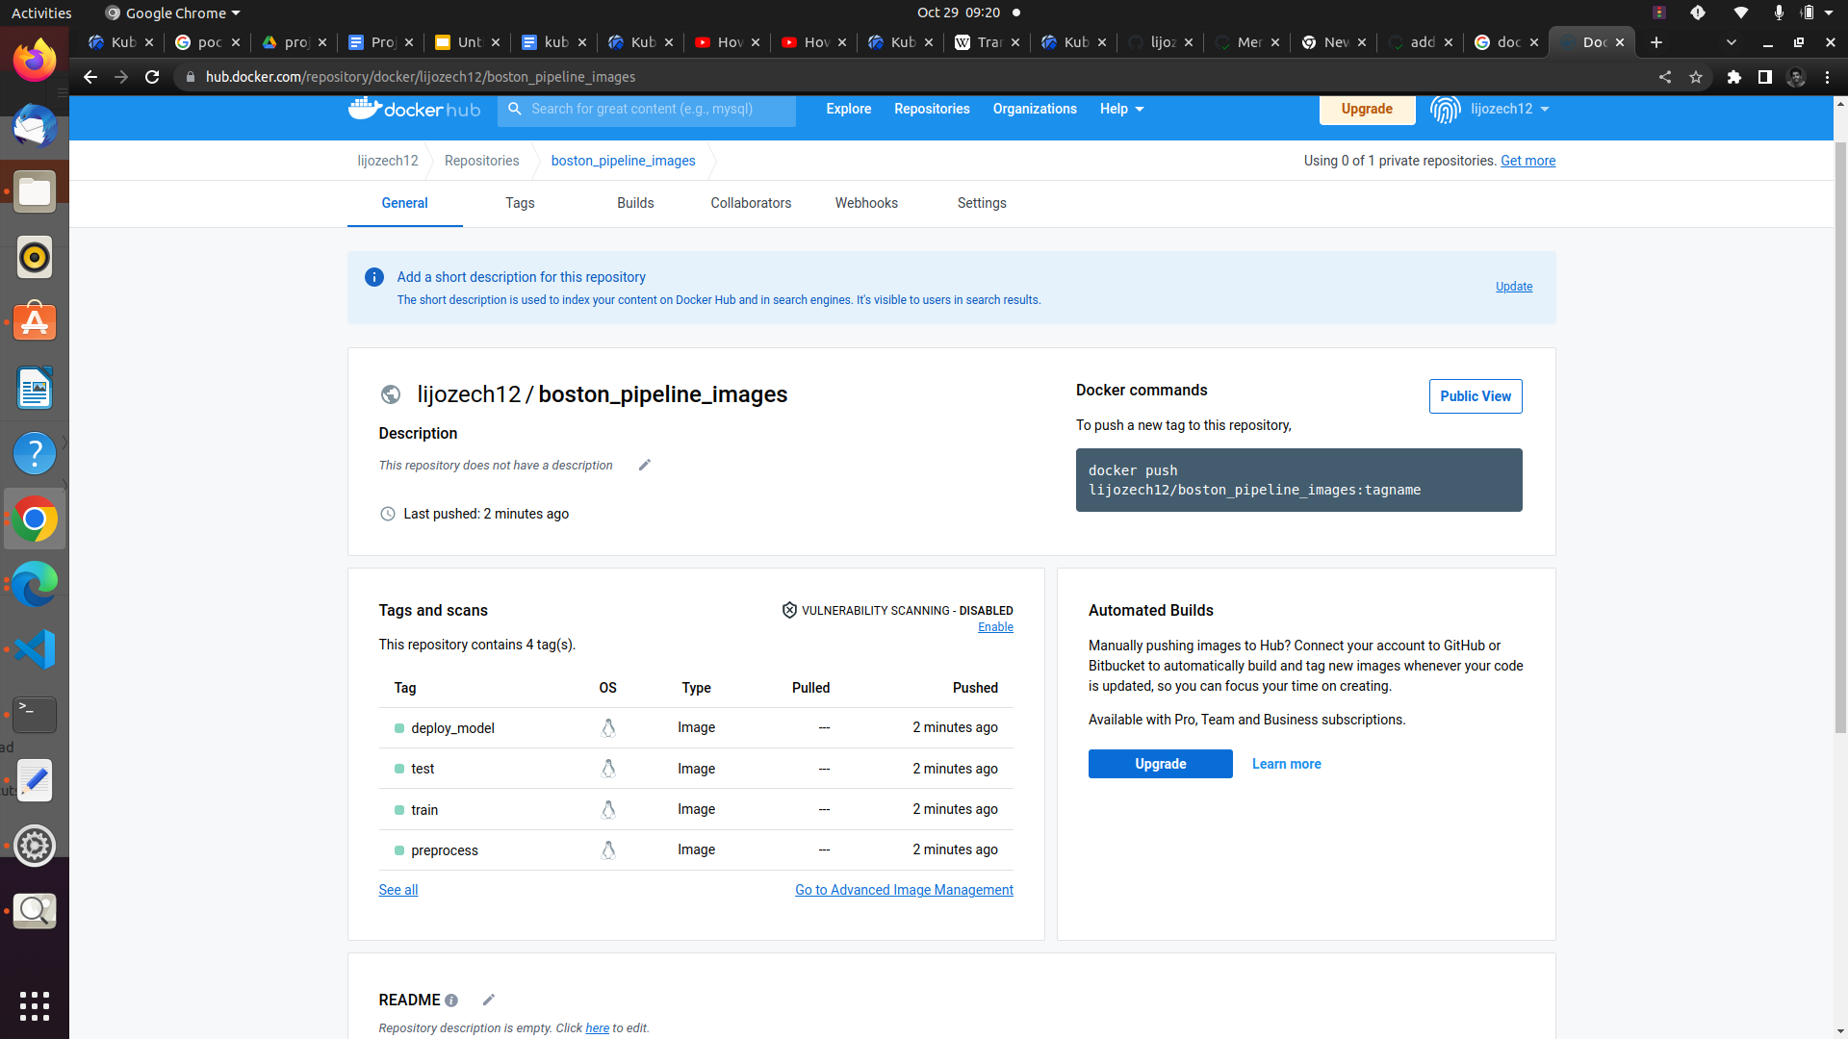
Implementation

Slide 13
Mlops Pipeline Output

Slide 14
FUTURE SCOPE
Only automation of docker images are done in this project. Automation of creating Pipelines when a change happens in github repo will be really useful.
Performance can be monitored using prometheus
Building more complex pipeline using kale

Slide 15
CONCLUSION
Made a cloud agnostic pipeline using Docker, kubernetes, kubeflow.
This pipeline can be run on any kubernetes cluster hosted any cloud or on prem

Slide 16
THANK YOU
LIJO ZECHARIAH JAMES

